Slide 1
Community Mental Health: What next for systems?

Slide 2

Brian Dow Deputy Chief Executive, Rethink Mental Illness
Webinar Chair

Slide 3




Housekeeping
This event will last until 2pm. It is being recorded and will be available on our website along with our previous webinars
There will be time for questions, please use the Q&A function to submit your questions to our speakers throughout the webinar
We will follow up via email with the recording to this webinar and other useful resources
We are using Microsoft Teams Townhall. Only the presenter speaking will be able to be seen and heard. Please bear with us during transitions between speakers

Slide 4
Agenda
Speaker | Content
Brian Dow, Deputy Chief Executive, Rethink Mental Illness | Chair’s welcome and housekeeping
Kathy Roberts, Chief Executive, Association of Mental Health Providers | Partnership with the Association of Mental Health Providers
Claire Murdoch, National Director for Mental Health, NHS England | Key achievements of Community Mental Health Transformation and what is next plus Q&A
David Woodhead, Associate Director of Research, Centre for Mental Health | Evaluation of local mental health alliances
Stephen Ryder, Managing Director, Creating Positive Opportunity | Place-based impact and reflections in North East Lincolnshire
Debbie Best, Lived Experience Carer & Activist | Reflections on involvement within the mental health system
All speakers | Questions from the audience
Brian Dow, Deputy Chief Executive, Rethink Mental Illness | Summary and close

Slide 5

Kathy Roberts Chief Executive, Association of Mental Health Providers
Partnership with the Association of Mental Health Providers

Slide 6

Claire Murdoch National Director for Mental Health, NHS England
Key achievements of Community Mental Health Transformation & what’s next

Slide 7
Adult Community Mental Health Transformation
Claire Murdoch CBE
National Mental Health Director, NHS England
Notes:
Standard title slide

Slide 8
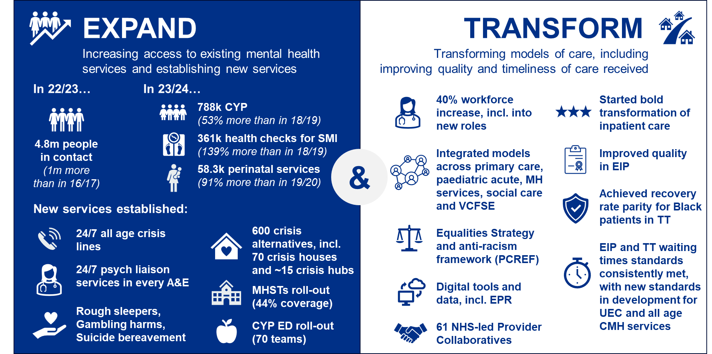
NHS Mental Health Services; Key achievements since 2016/17
Non-exhaustive
Notes:
Plain slide with subhead and bullets

Slide 9
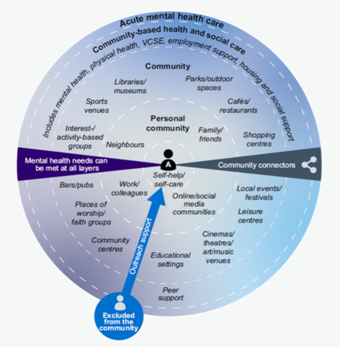
Adult Community Mental Health; Our transformation journey
Five Year Forward View for Mental Health: 2016
Long Term Plan: 2019
Community Mental Health Transformation Framework: 2019/20
Community Mental Health Transformation Road Map: 2022/23
Current Year: 2024/25
Year of consolidation / Planning for the next 5 years
Transformed community mental health services are integrated with wider support that is centred on people and their needs

Slide 10

24/25 Key Priority in Adult Community Mental Health; Waiting times
2022
2023
2024/25
NHS England committed to introducing a waiting time metric in CYP and Adult Community Mental Health Services, in line with the Clinically-Led Review of Standards (CRS). The metric looks at the length of time it takes someone to start receiving meaningful help. ​
In November 2023, NHS England published data on the median and longest waits in CYP and Adult CMH. We will be publishing data in Autumn 2024 on the proportion of people receiving meaningful help within 4 weeks.
We are asking systems to focus on reducing long waits in Children and Young People and Adult Community Mental Health services. We will be working with systems to develop agreed baseline and improvement trajectories for waits over 104 weeks
Notes:
Sample 3 column icon slide
Alt text is included in these images

Slide 11

24/25 Key Priority in Adult Community Mental Health; Outcomes
In 2023, guidance to support implementation in community services was released by National Collaborating Centre for Mental Health in 2023 and systems are encouraged to ensure routine and meaningful use of PROMs in services
A suite of 3 complementary patient recorded outcome measures (PROMs) are recommended for community mental health services for people with severe mental illness.
DIALOG
Goal Based Outcomes
ReQol-10
Looks at persons satisfaction with different areas of their health and life as well as their support care and treatment
Focuses on what the person wants to get out of their support, care and treatment and progress against those goals
Looks at understanding the person’s quality of life and how that is linked to their personal recovery

Slide 12

24/25 Key Priority in Adult Community Mental Health; Expanding access to IPS and NHS Talking Therapies
The 2023 Autumn Statement invested around £800m into NHS Talking Therapies and Individual Placement Support (IPS) over a five-year period. For IPS this built on investment in the 2023 Spring Budget.
This new funding marks the start of new targets being set for these programmes which supersede the Long Term Plan (LTP) targets. For the rest of the Mental Health programme the LTP remains.
NHS Talking Therapies (NHS TT)
Individual Placement Support (IPS)
Additional funding for 348,000 more people, by 2028/29, to have a course of treatment in NHS TT, for anxiety and depression. Also increasing average number of sessions so a greater proportion of patients can recover
Additional funding for IPS for Severe Mental Illness to increase access to services by 140,000 by 2028/29
In 2023/24 37k people accessed IPS services, in 2024/25 we expect to see 40,500 to access IPS services

Slide 13
24/25 Delivery priorities for Adult Community Mental Health
During 2024/25 we must all focus on our key priorities; access, waiting times and outcomes
Continue to achieve existing waiting time standards in NHS Talking Therapies and Early Intervention in Psychosis services
Focus on reducing long waits, agreeing baseline and improvement trajectories for waits over 104 weeks
Increase the number of people with severe mental illness receiving a full annual physical health check
Increase reliable improvement and reliable recovery rates in NHS Talking Therapies
Improving care and treatment for people with complex psychosis, especially for those who require intensive community treatment and follow-up
Increase the number of adults and older adults completing a course of treatment via NHS Talking Therapies
Increase the number of people accessing transformed models of adult community mental health
Increase access to IPS for Severe Mental Illness
NHS England will also be focussing on how we can further expand and improve the quality of services, including further Community Mental Health guidance around core standards of care, and evaluating the impact of the transformation to date

Slide 14






Supporting the new Government
8,500 more mental health staff
Reducing waiting times
Mental Health Act reform
Expanding Mental Health Support Hubs in schools
Implementing neighbourhood hubs
Supporting Work, Economy and wider Government agenda
Notes:
Sample icon grid slide – 6 icons (inc. alt text)

Slide 16

David Woodhead Associate Director of Research, Centre for Mental Health
Evaluation of local mental health alliances

Slide 18
THE RESEARCH
Over the past three years, Centre for Mental Health has conducted a research project, funded by CAF, on the impact and groundbreaking potential of local mental health alliances led by Rethink Mental Illness in Coventry and Warwickshire, North East Lincolnshire, Sheffield, and Tower Hamlets.

Slide 19
Mental Health Alliances are collaborative efforts among various local stakeholders – such as VCSE organisations, commissioners and providers of health and social care, and experts by experience – to provide support for people severely affected by poor mental health. These alliances work toward destigmatising mental illness, improving access to support and treatment, and encouraging innovation.
Mental Health Alliances

Slide 20
OUR FOCUS
The evaluation questions focused on:
How mental health alliances are formed and governed
The benefits and challenges of VCSE organisations and experts by experience
The influence of mental health alliances on the provision and quality of mental health services and support
Commonalities and differences between alliances
Key lessons and recommendations for developing and supporting mental health alliances in other localities and regions in the future.

Slide 21
An in depth literature review of peer reviewed and grey literature, policy documents
Over three years – initiation, implementation and delivery - we spoke in depth, on several occasions, one to one and in groups, to colleagues from Rethink (n=8) in each of the sites, also to local stakeholders, including experts by experience (n = 38)
In the final months, a questionnaire was distributed to local stakeholders including experts by experience (n = 70)
In depth case studies were developed – drawing on a range of data sources and insights
How we did the research

Slide 22
IN SUMMARY
The research demonstrates that mental health alliances are essential for enhancing the quality and availability of mental health services and support.
In each of the four sites we studied, the alliances have had significant impact on their local systems, from which many insights about cross-sector collaboration have emerged.
Understandably, as the programme draws to a close, there is a fear that the systems will fall back into old patterns of working. Sustainable funding to build on what has already been achieved is welcome.

Slide 23
KEY FINDINGS
Responding to local context was crucial. For example, the VCSE sector faces multiple challenges, such as strong dynamics between providers, financial constraints, and lack of coordination with other providers.
Clear and regular communication was essential in building trust and creating the conditions in which collaboration between VCSE sector organisations, experts by experience and other stakeholders could come to fruition.
Initiating an alliance and maintaining momentum could be challenging, but clear assurances about the alliance's purpose helped keep focus and commitment.

Slide 24
KEY FINDINGS
Trust was paramount for the success of the alliances and was the bedrock for meaningful collaboration.
Taking enough time to build effective alliances – despite the urgency of the task and impatience to be effective – was crucial. Defining their focus in relation to service delivery was important and allowed for clarity about purpose and commitment.
Coproduction with experts by experience was challenging but essential. Community engagement and open-door policies were key as they connected people and improved communication between services.

Slide 25
KEY FINDINGS
Alliances were able to effectively tackle broader issues such as eurocentrism and racism in mental health interventions, and help improve mental health outcomes and experiences for people from minoritised communities.
Meaningful VCSE sector engagement collaboration required financial backing to facilitate the engagement of smaller organisations in the alliances and to avoid them competing for the same funding sources.
Successful collaboration relied on practical aspects such as sufficient notice for meetings, prompt minutes from meetings, and easy access to parking, meeting rooms, and meeting spaces.

Slide 26
RECOMMENDATIONS (1)
Integrated Care Boards (ICBs) should resource, develop, support and work with mental health alliances.

Slide 27
RECOMMENDATIONS (2)
The Department for Health and Social Care should incorporate the core principles of mental health partnerships into the broader strategy for health and social care to establish a unified and clear vision for mental health.

Slide 28
RECOMMENDATIONS (3)
NHS England should secure a binding commitment from Integrated Care Boards (ICBs) to provide ongoing and sustainable resources for mental health alliances as part of a long-term funding plan for mental health initiatives. This could be achieved in future annual planning guidance and strategies following the Long Term Plan.

Slide 29
RECOMMENDATIONS (4)
NHS England should encourage the development of networks of mental health alliances across all integrated care systems (ICSs), by issuing improved guidance around commissioning, working proactively with systems to reduce barriers to collaborative working, and introducing light-touch access to community mental health transformation funding for grassroots organisations.

Slide 30
RECOMMENDATIONS (5)
Mandate local systems to prioritise coproduction – as set out in statutory guidance from NHS England – and hold them to account for its implementation.

Slide 31
RECOMMENDATIONS (6)
The DHSC should establish a national evaluation and learning framework that comprehensively and independently assesses the impact of mental health alliances and suggests areas for improvement, while maintaining transparency and accountability at every stage, and use its findings to inform future policy-making and practice.

Slide 32
More than the sum of our parts
Find the reports from this research at www.centreformentalhealth.org.uk:
Report: More than the sum of our parts: an evaluation of mental health alliances
Case study: Coventry and Warwickshire
Case study: North East Lincolnshire
Case study: Sheffield
Cased Study: Tower Hamlets
Report: Mental Health Alliances: a review of the literature

Slide 34
David.Woodhead@centreformentalhealth.org.uk
Nick.Treloar@centreformentalhealth.org.uk
Katie.Yau@centreformentalhealth.org.uk
@CentreforMH

Slide 35

Stephen Ryder Managing Director, Creating Positive Opportunity
Place-based impact in North East Lincolnshire

Slide 36

Debbie Best Lived Experience Carer & Activist
Reflections on involvement within the mental health system

Slide 37

Questions from the audience to our panel of speakers

Slide 38
How we can support systems
Self-Assessment Assurance Framework:
Free online self-assessment tool, which takes 10 minutes to complete
Assess your system or partnership’s progress across Community Mental Health Transformation
Community Mental Health Progress Evaluation Programme:
Three-month tailored assessment of the status of Community Mental Health Transformation in an ICS footprint
Our team of experts will help you understand how to overcome challenges and strengthen successes
Tailored support with coproduction programmes, involvement and facilitation
Email us on CMHFsupport@rethink.org to set up a discussion

Slide 39
Thank you to all our speakers and attendees for joining today We look forward to seeing you soon at our next event

